Slide 2

Excel 2011
Analyze data with a PivotTable

Slide 3

Overview
A PivotTable is an interactive table that makes it simple to summarize and analyze large amounts of data in different ways. Watch this series of videos to learn how.

Slide 4
Learning objectives
After completing this video, you'll be able to:
Prepare sheet data so that Excel can create a PivotTable.
Have Excel automatically create a PivotTable for you.
Find and use the PivotTable Builder and other PivotTable tools.
Change how the PivotTable summarizes your data.
Format and update the PivotTable.
NOTE: Video lessons are designed to be viewed in order. Use the practice file PivotTables.xlsx for hands-on experience while watching this video.

Slide 5

1. Introduction (1:13)

Slide 6

2. Prepare the sheet and create a PivotTable (1:09)

Slide 7

3. Explore the PivotTable tools (1:28)

Slide 8

4. Change the PivotTable summary (1:10)

Slide 9

5. Change the summary function and filter (1:19)

Slide 10
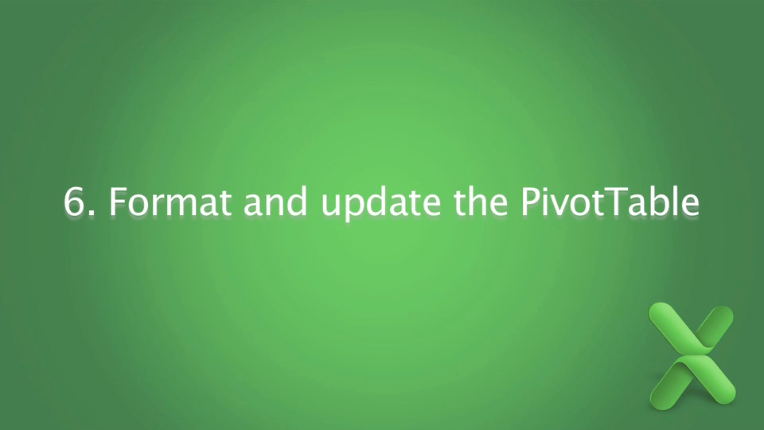
6. Format and update the PivotTable (1:22)

Slide 11

© 2010 Microsoft Corporation. All rights reserved. Microsoft, Windows, Windows Vista and other product names are or may be registered trademarks and/or trademarks in the U.S. and/or other countries.
The information herein is for informational purposes only and represents the current view of Microsoft Corporation as of the date of this presentation. Because Microsoft must respond to changing market conditions, it should not be interpreted to be a commitment on the part of Microsoft, and Microsoft cannot guarantee the accuracy of any information provided after the date of this presentation. MICROSOFT MAKES NO WARRANTIES, EXPRESS, IMPLIED OR STATUTORY, AS TO THE INFORMATION IN THIS PRESENTATION.

